Slide 1
Training Alexnet to perform visual perceptual learning task

Slide 2
Low-level visual perceptual learning

Slide 3
Alexnet
9 layers, to classify 1000 objects.
5 convolutional layer, 3

Slide 4
Provisional play
First test orientation performance on 9 different layers
Across noise levels
Four spatial location
Two orthogonal orientations.
Train Alexnet to perform orientation identification task
read out from 8 different layers. That means

Slide 5
Low-level visual perceptual learning
Problem
Which layer to readout?

Slide 6
Low-level visual perceptual learning
Theoretical questions:
High-level learning or low-level learning
Generalization to other low-level dimensions
Gabor training and face training.

Slide 7
Results for Clean Images

Slide 8
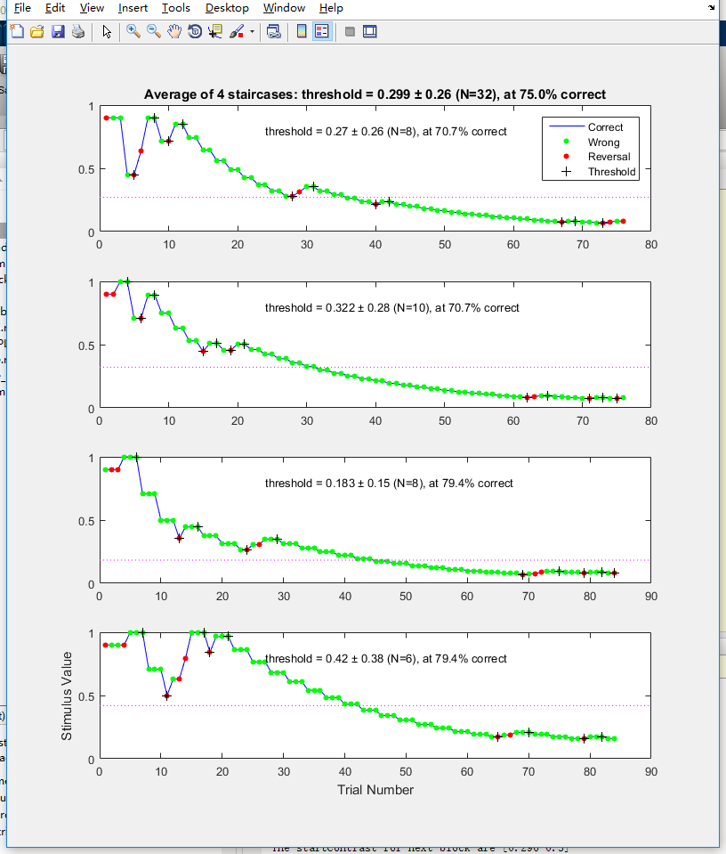
Layer : Relu1
LearningRate : 1e-3
WeightDecay : 5e-4

Slide 9
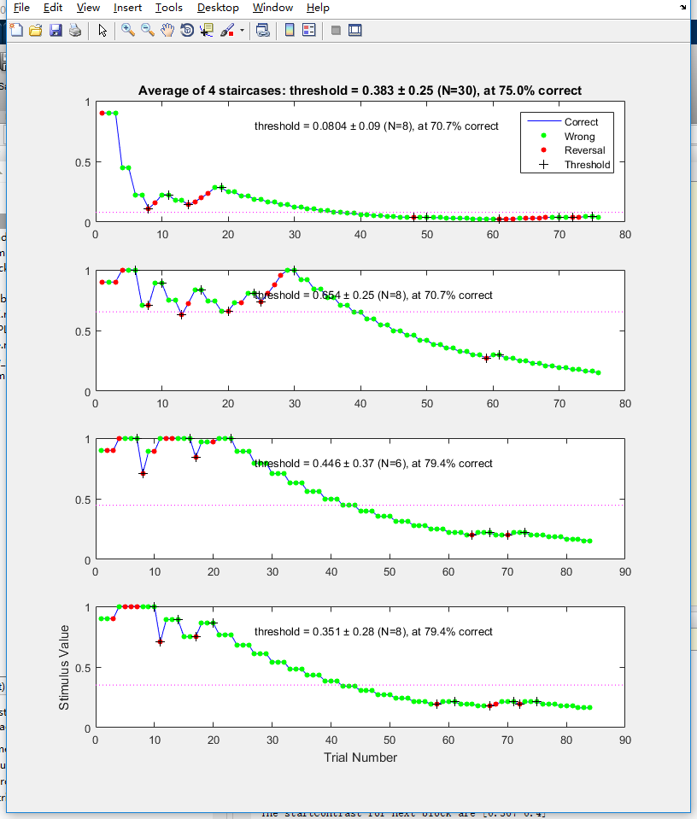
Layer : Relu2
LearningRate : 1e-3
WeightDecay : 5e-4

Slide 10
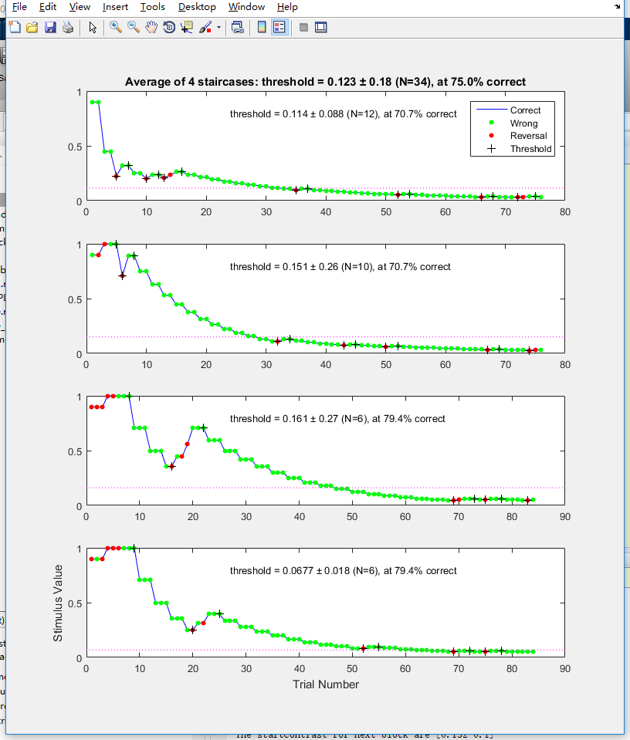
Layer : Relu3
LearningRate : 1e-3
WeightDecay : 5e-4

Slide 11
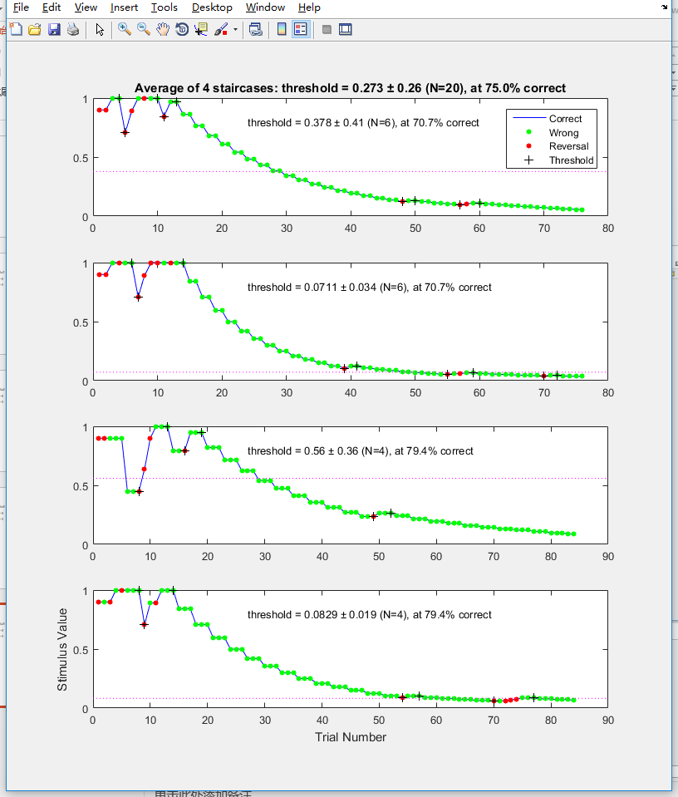
Layer : Relu4
LearningRate : 1e-3
WeightDecay : 5e-4

Slide 12
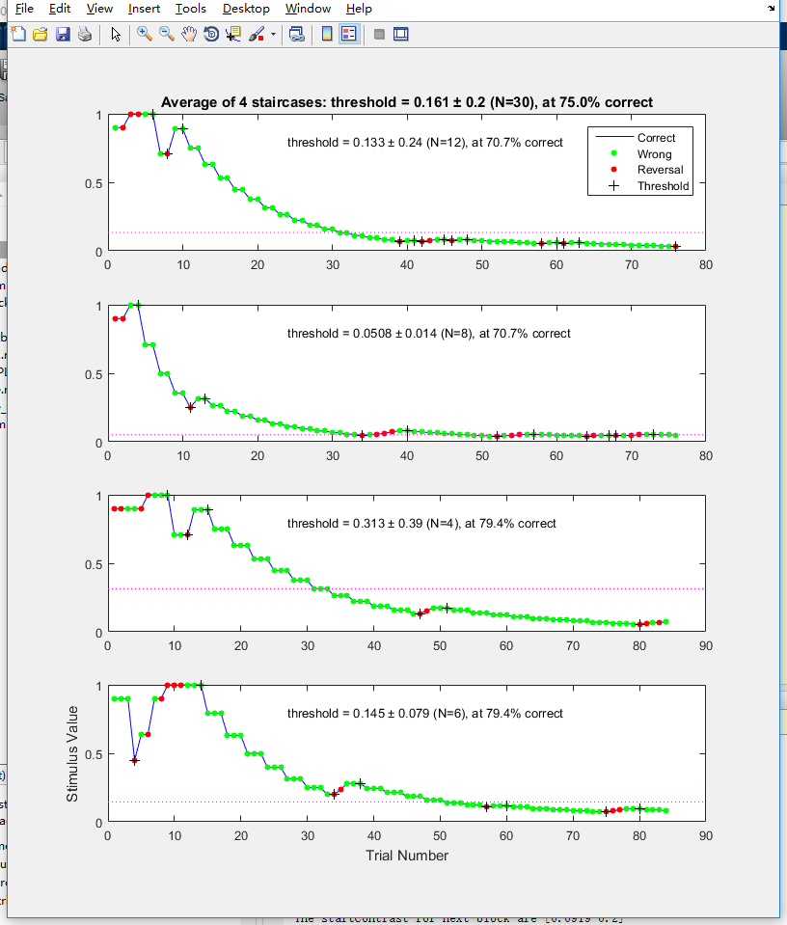
Layer : Relu5
LearningRate : 1e-3
WeightDecay : 5e-4

Slide 13
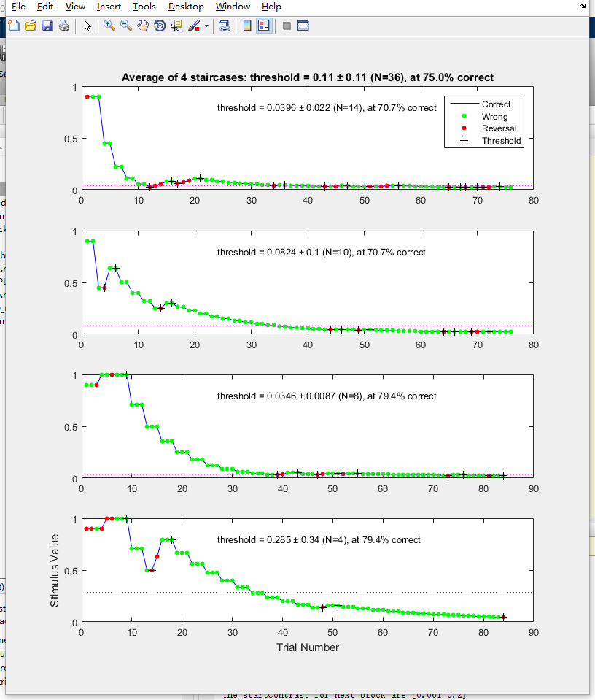
Layer : Relu6
LearningRate : 1e-4
WeightDecay : 5e-4

Slide 14
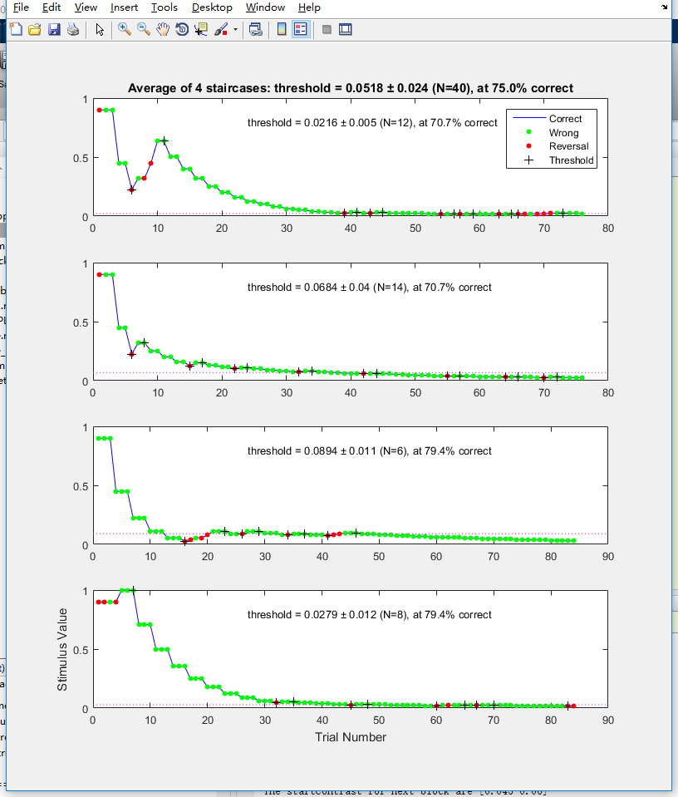
Layer : Relu7
LearningRate : 1e-3
WeightDecay : 5e-4

